Slide 1

QA Team Report Summary[Dev 6]
Hari Vinayak Sai Kandikattu - 40219582
Akash Rajmohan - 40218469
Karthini Rajasekharan - 40238556
Manish Pejathaya - 40194909
[Dev 5] Under Test
Professor: Dr. Yan Liu

Slide 2
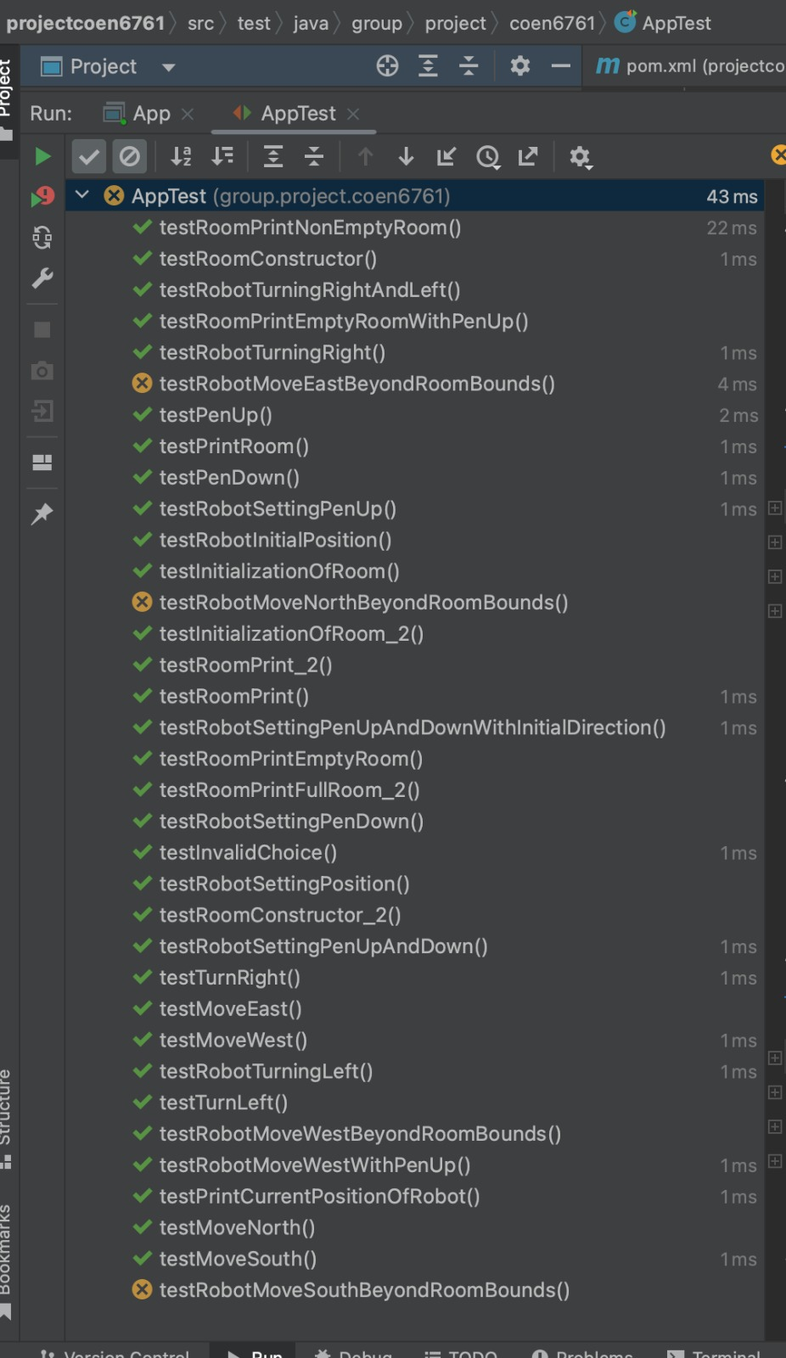
Overall Summary of QA Testing
Systematic testing methods applied:
JaCoCo testing tool
PIT test
Ratio test cases passed/total:
White-box testing – 19/22 test cases - passed

Slide 3
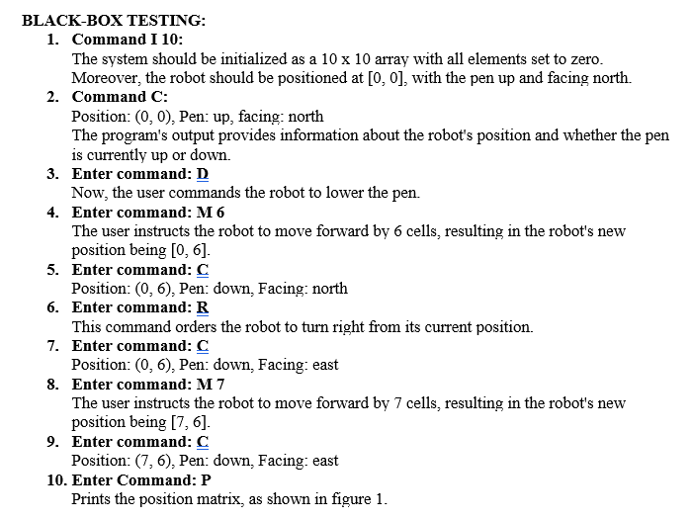
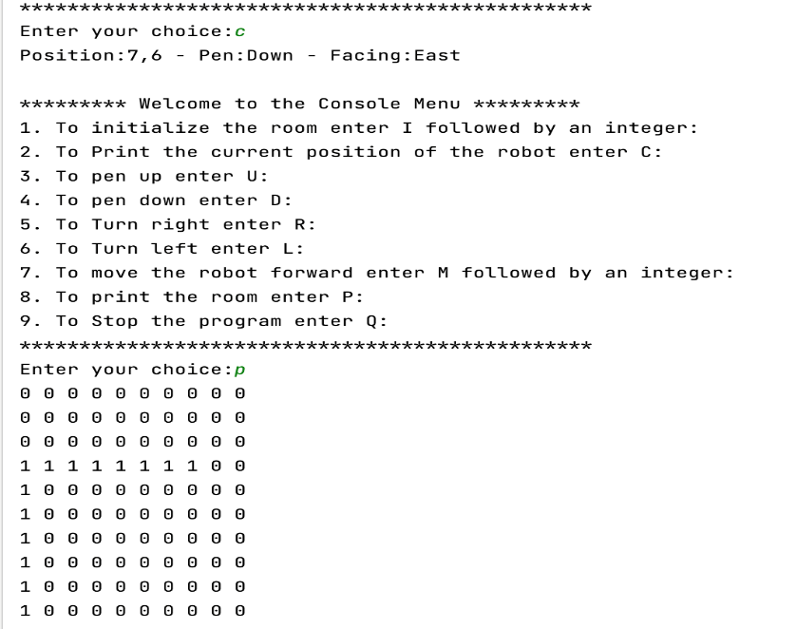
Black-box Testing

Slide 4
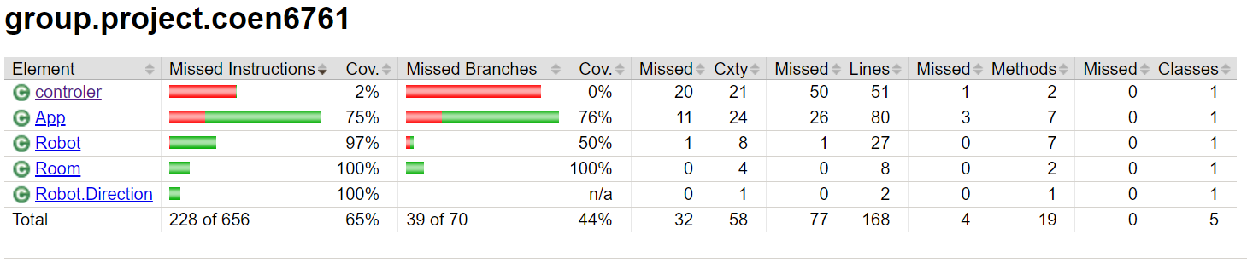
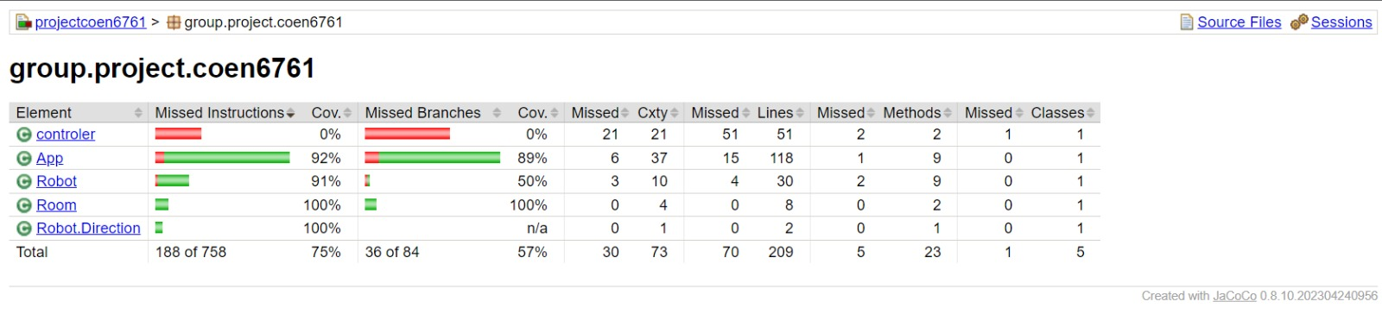
Overall Summary of QA Testing
Test Coverage:
We have performed code coverage for the development team using JaCoCo testing tool and our coverage result turns out to be 10% higher than the actual coverage results of the development team.
Code Coverage results produced by the Development Team
Code Coverage results produced by our team

Slide 5
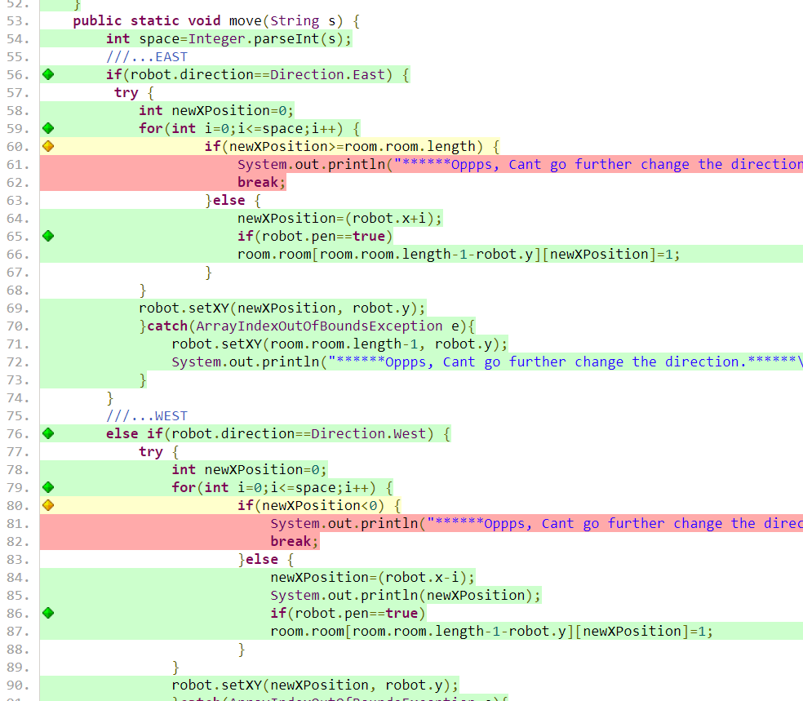
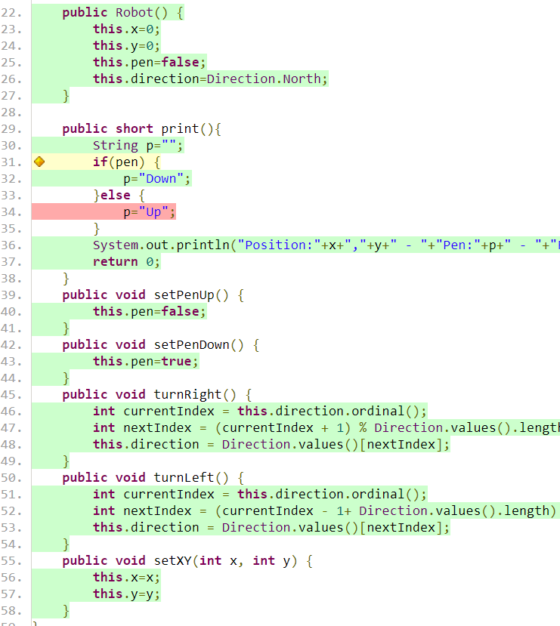
Screenshots of test coverage

Slide 6
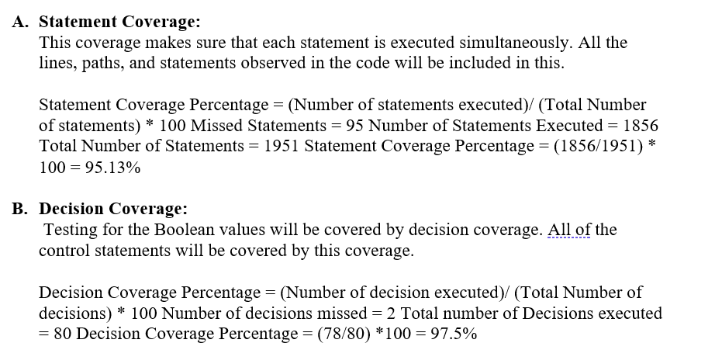
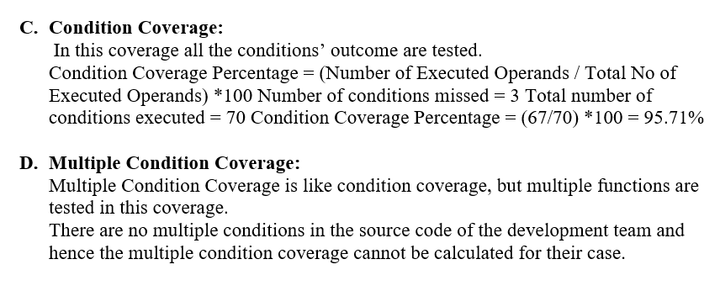
Overall Summary of QA Testing
Coverage:

Slide 7
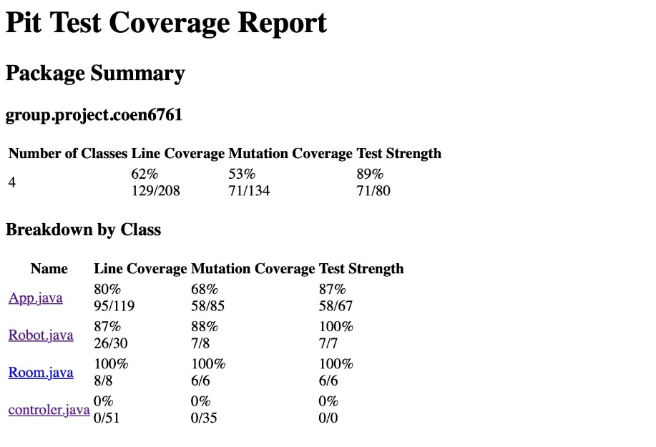
Overall Summary of QA Testing
Mutation testing:

Slide 8
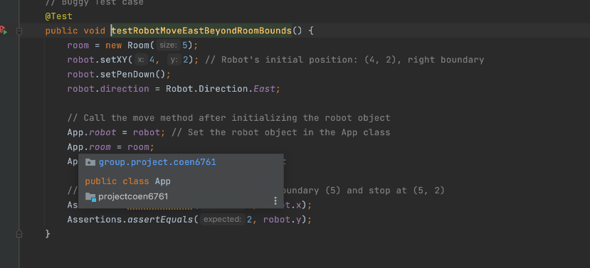
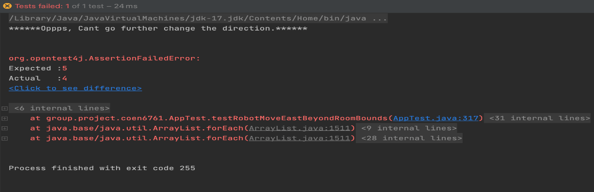
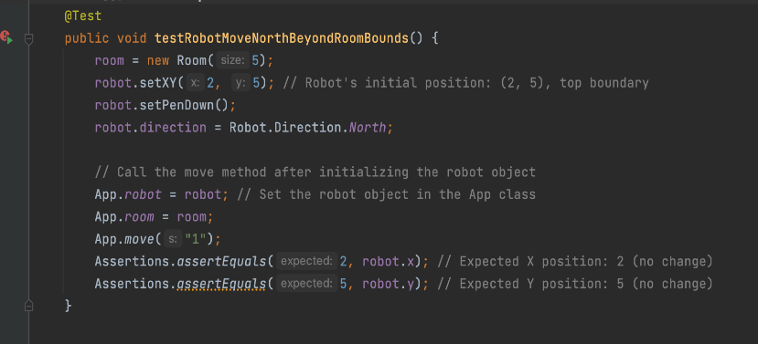
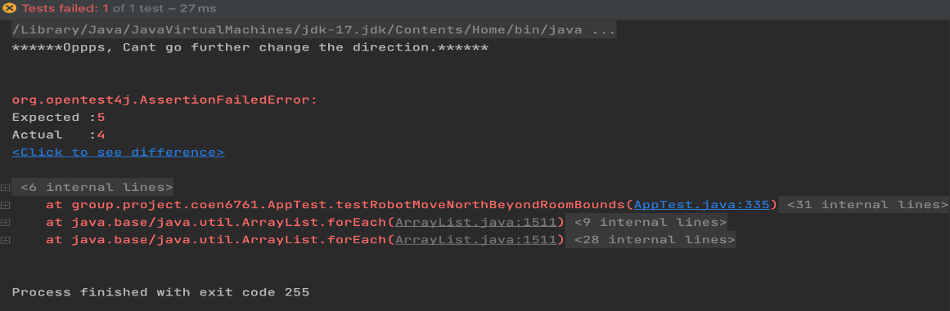
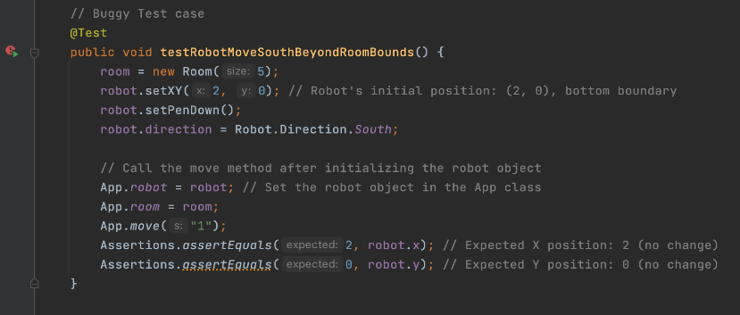
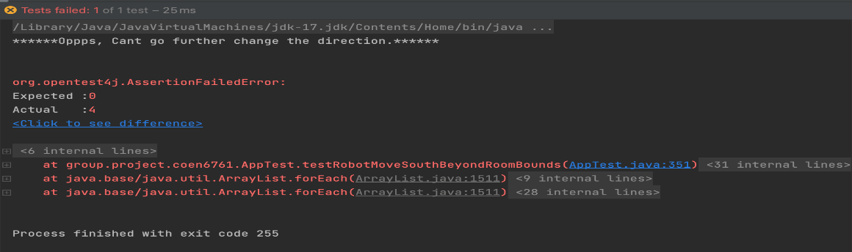
Overall Summary of QA Testing
Number of errors, exceptions and bugs found:

Slide 9
Overall Summary of QA Testing
Comments to the Dev Team
Overall, the project was working fine and passed 19 out of the 22 UTCs.
The Robot program was not performing as expected for few out of bounds test cases. This was captured in the report and screenshots were provided.
Example: Robot Position: (0,0) Direction: West Now, tries to move out of bound in the direction, the program prints the expected response. But the Robot position is changed and gives wrong output when we run the C- command later. The above-mentioned case happens in all directions when the Robot tries to move Out of bounds, which must be fixed by the DEV team.

Slide 10
Overall Summary of QA Testing
Learning experience
As a team we had a rich learning experience from this QA project.
3 out of 4 – Newcomers to Java.
Learned about different types of Testing.
QA Team was set up for Task -1, however, for Task-2, we had to setup QA from the beginning.

Slide 11
Dev Team Response Summary[Dev 6]
Hari Vinayak Sai Kandikattu - 40219582
Akash Rajmohan - 40218469
Karthini Rajasekharan - 40238556
Manish Pejathaya - 40194909

Slide 12

Fixed Issues

Slide 13
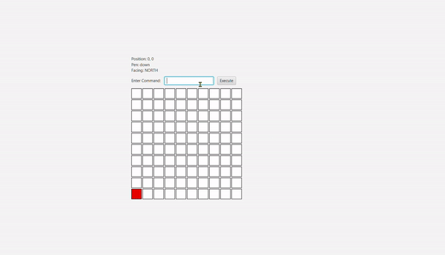

QA’s Comments: (Print Operation Issue) “The robot does not draw on the slot it’s on when it first lowers the pen, it only starts drawing after it moves to another slot on the floor. “
Before Fixing
After Fixing

Slide 14
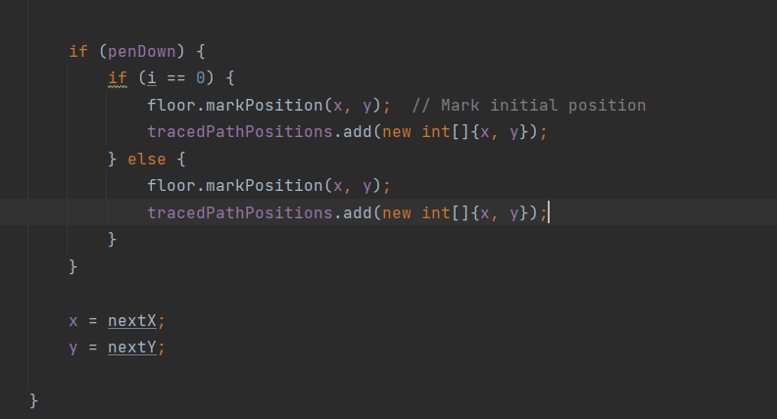
QA’s Comments:(Print Operation Issue) “The robot does not draw on the slot it’s on when it first lowers the pen, it only starts drawing after it moves to another slot on the floor. “
A small change made to the Move()

Slide 15
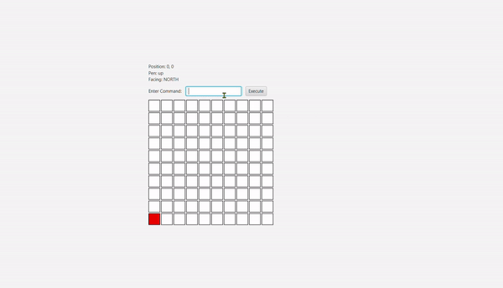
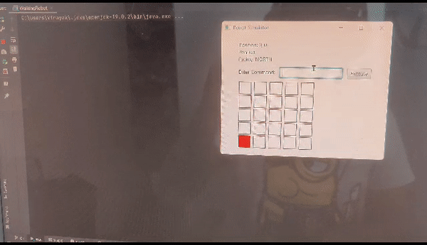
QA’s Comments: ( Exit Command Issue) “The end program command “Q” does not function correctly, as we are still able to perform movements and run the program on the GUI even after using this command”
Before Fixing
After Fixing

Slide 16
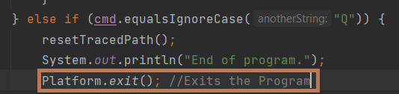
QA’s Comments: ( Exit Command Issue) “The end program command “Q” does not function correctly, as we are still able to perform movements and run the program on the GUI even after using this command”
A single line change made in the else if condition for command Q

Slide 17
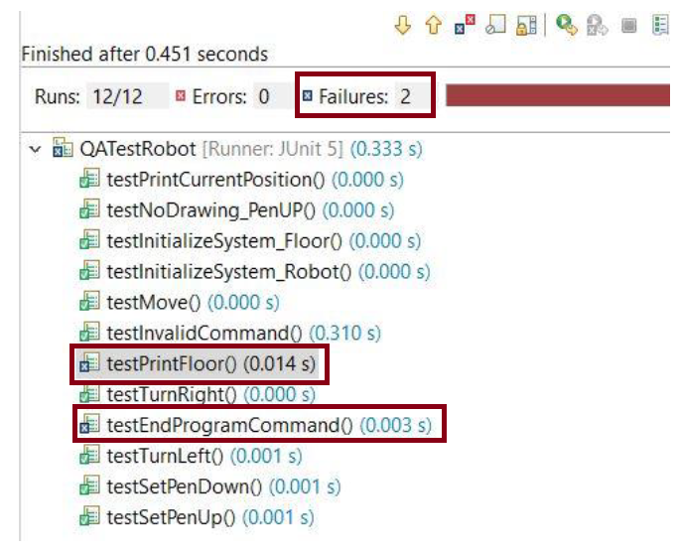
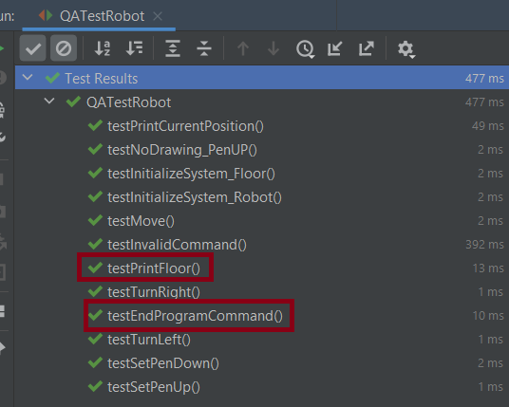
Test Cases
Screenshot taken from QA Team’s report where test cases were initially failing.
All test cases passed after Fixing

Slide 18
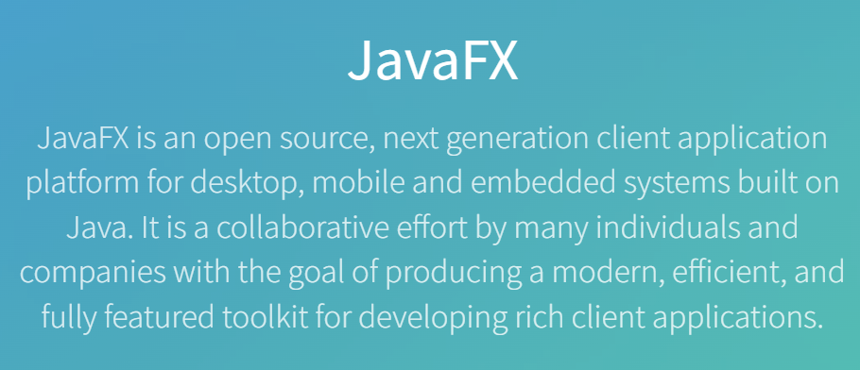

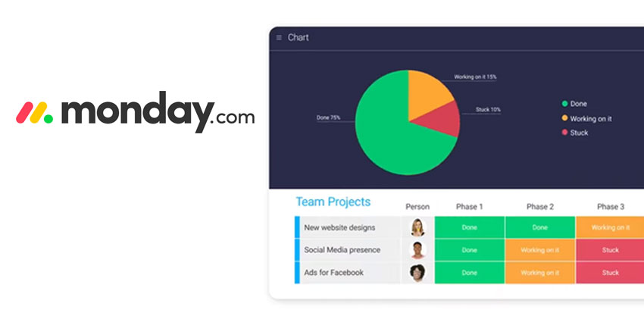

Learning experience

Slide 19
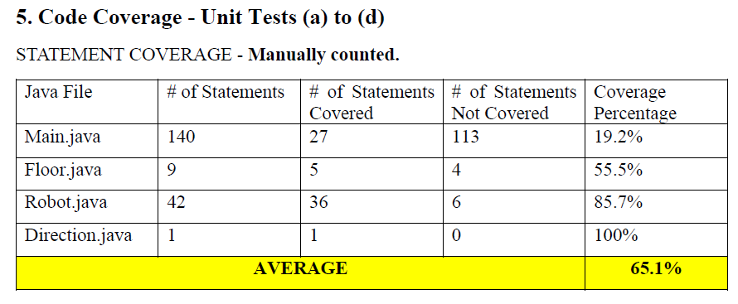


Improved Code Coverage by learning a New Technology (TestFX)
Test Coverage of QA Team for the Main.class
which is only 19.2%
Test Coverage done by us for the main class which is of 72%
These Testcases written using TestFX to increase the code coverage for Main.Class that implements the JavaFX GUI

Slide 20

Thank You

